Slide 1

Institute Scouter : Online Admission College Information System
1.Jemin Bhanushali-20104109
2.Maaz Mirza -20104124
3. Hamza Ansari- 20104058
Project Guide
Ms. Manasi Choche

Slide 2
Contents
Introduction
Objectives
Scope
Literature Survey
Proposed System
Project Outcomes
Block Diagram
Use Case/DFD
Technology Stack
Suggestions in Review-1
Results and discussion
Conclusion and future scope
References

Slide 3

1. Introduction
Problem Identified :
Students and parents are struggling gathering information about colleges during the admission procedure.
Solution Proposed :
We are providing a user-friendly website for students, parents and educationalist that helps them make better decisions in the selection of college.

Slide 4
2. Objectives
To make GUI/App user friendly.
To make college selection easy for students looking to pursue undergraduate and postgraduate.
To make the hectic admission procedure effortless by providing suitable and specific information.
To reduce paper work and time.

Slide 5
3. Scope
Can help students decide to choose suitable colleges.
Can be useful to students and parents.
Students can see courses related to their stream.

Slide 6
4. Literature Survey
College Recommendation System(IJERT) ISSN: 2278-0181 IJERTV9IS060267 (This work is licensed under a Creative Commons Attribution 4.0 International License.) Published on April-2018
"College Recommendation System" by "Leena Despande,Nilesh Dikhale, Himanshu Shrivastav ", in this paper they had proposed a college recommendation system. This system is made for students, parents and educationalist who aims to search engineering colleges. Recommendation systems solve the problem of information overload by searching through large volumes of data. There are different prediction techniques that help recommendation systems to obtain data.

Slide 7
5. Proposed System
We have simple and interactive user interface.
We provide detailed information about the Colleges at one place.
User can get information about Undergraduate/Postgraduate Courses, fees & Placements.
Also user can see college review.

Slide 8
6. Outcome of Project
Innovation to solve one of the greatest challenges faced by students and parents during admission procedure.
User can Login in his/her account .
User can search for colleges.
User can get detailed information about colleges.
User can access information from anywhere anytime
Our website is responsive.

Slide 9
7. Block Diagram
HOMEPAGE
MANAGEMENT
MEDICAL
ENGINEERING
ABOUT US
LOGIN/REGISTRATION
COLLEGES
COURSES/FEE
PLACEMENTS
REVIEWS

Slide 10
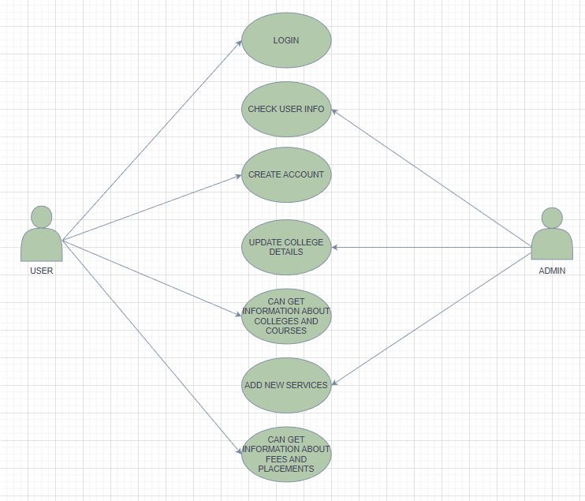
8. Use Case:

Slide 11



9. Technology Stack
-HTML
-CSS
-JAVA SCRIPT

Slide 12
10.Suggestions in Review-1
Literature Survey.
To add search bar on the homepage.
To add email validation.
To add related courses in each stream section.

Slide 13
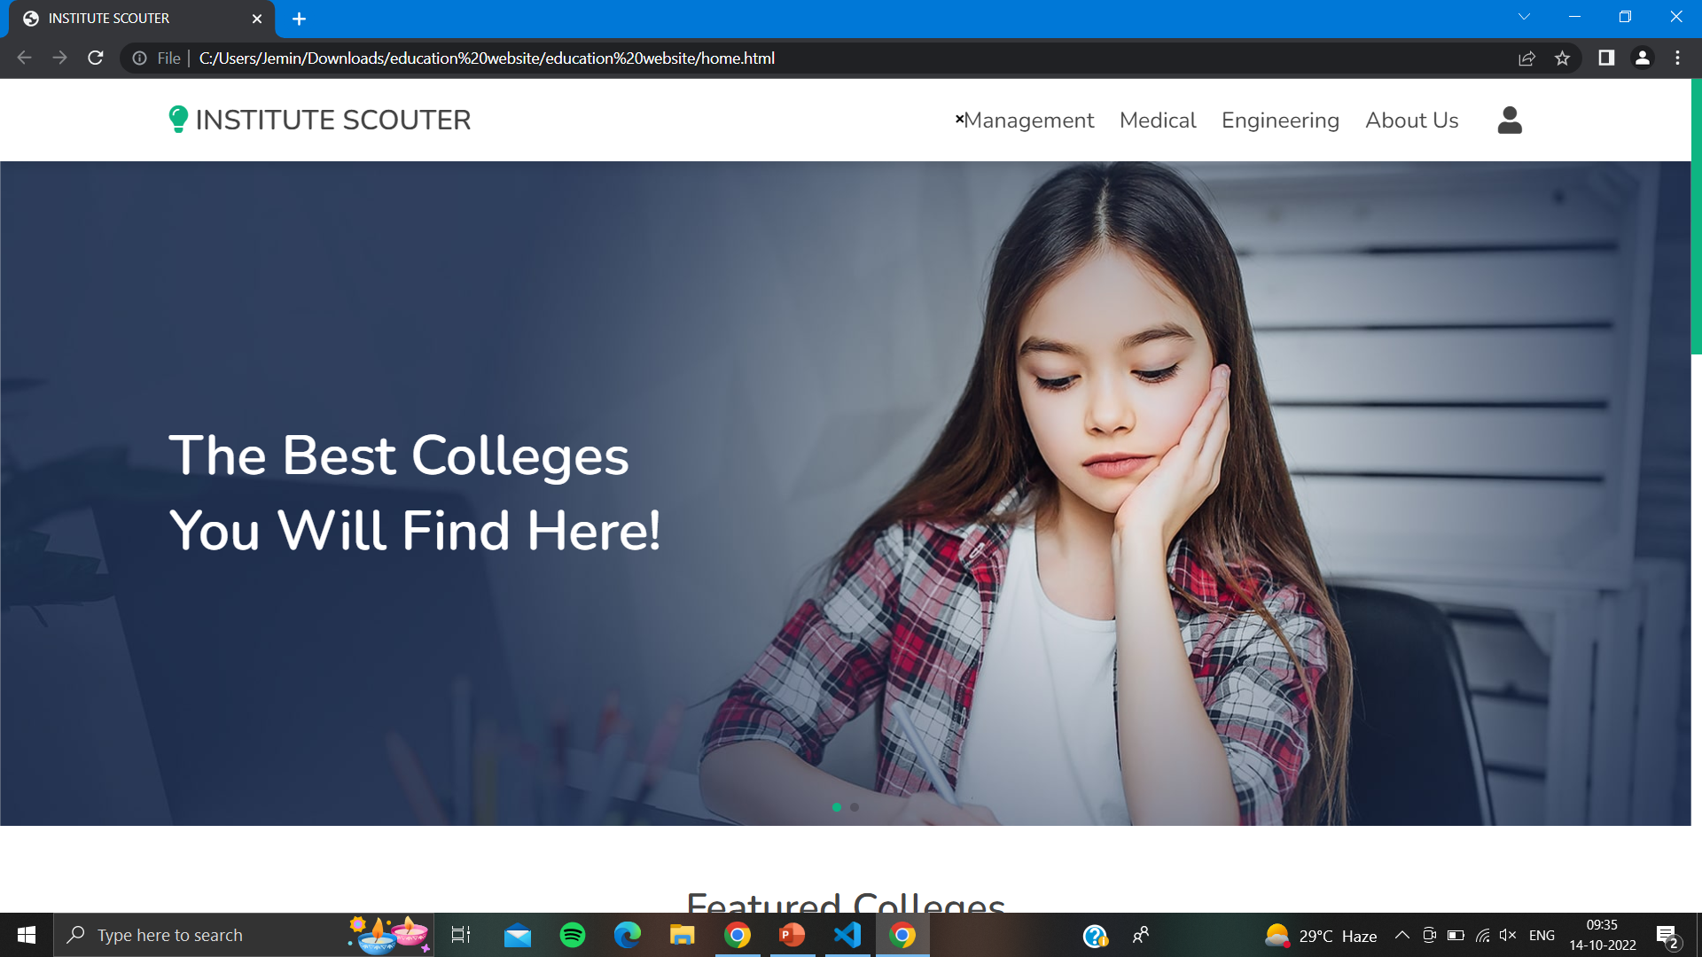
11. Results and discussion.
1.HOME PAGE:

Slide 14
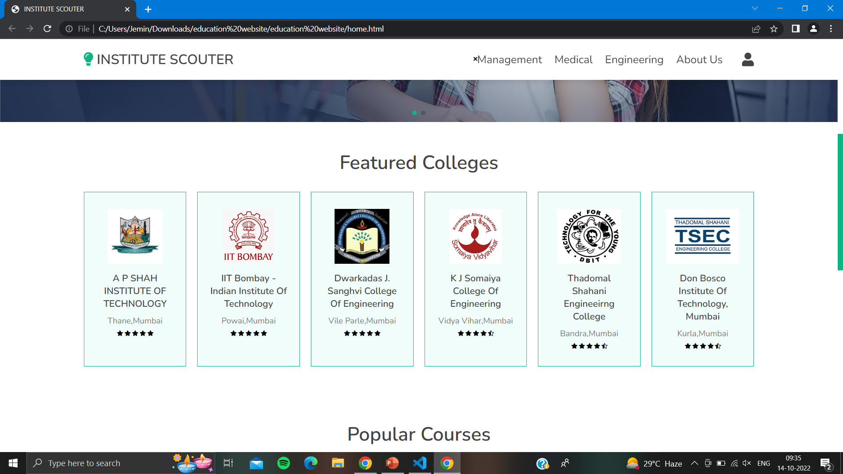
2: Home Page:

Slide 15
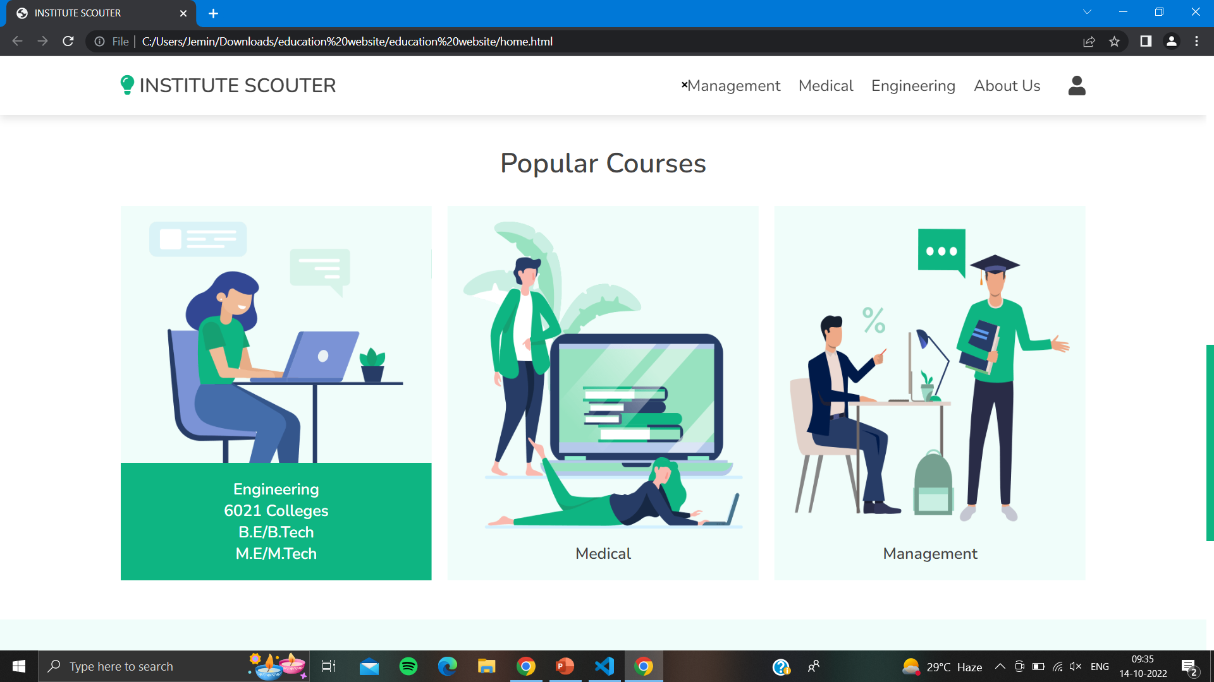
3: Home Page:

Slide 16
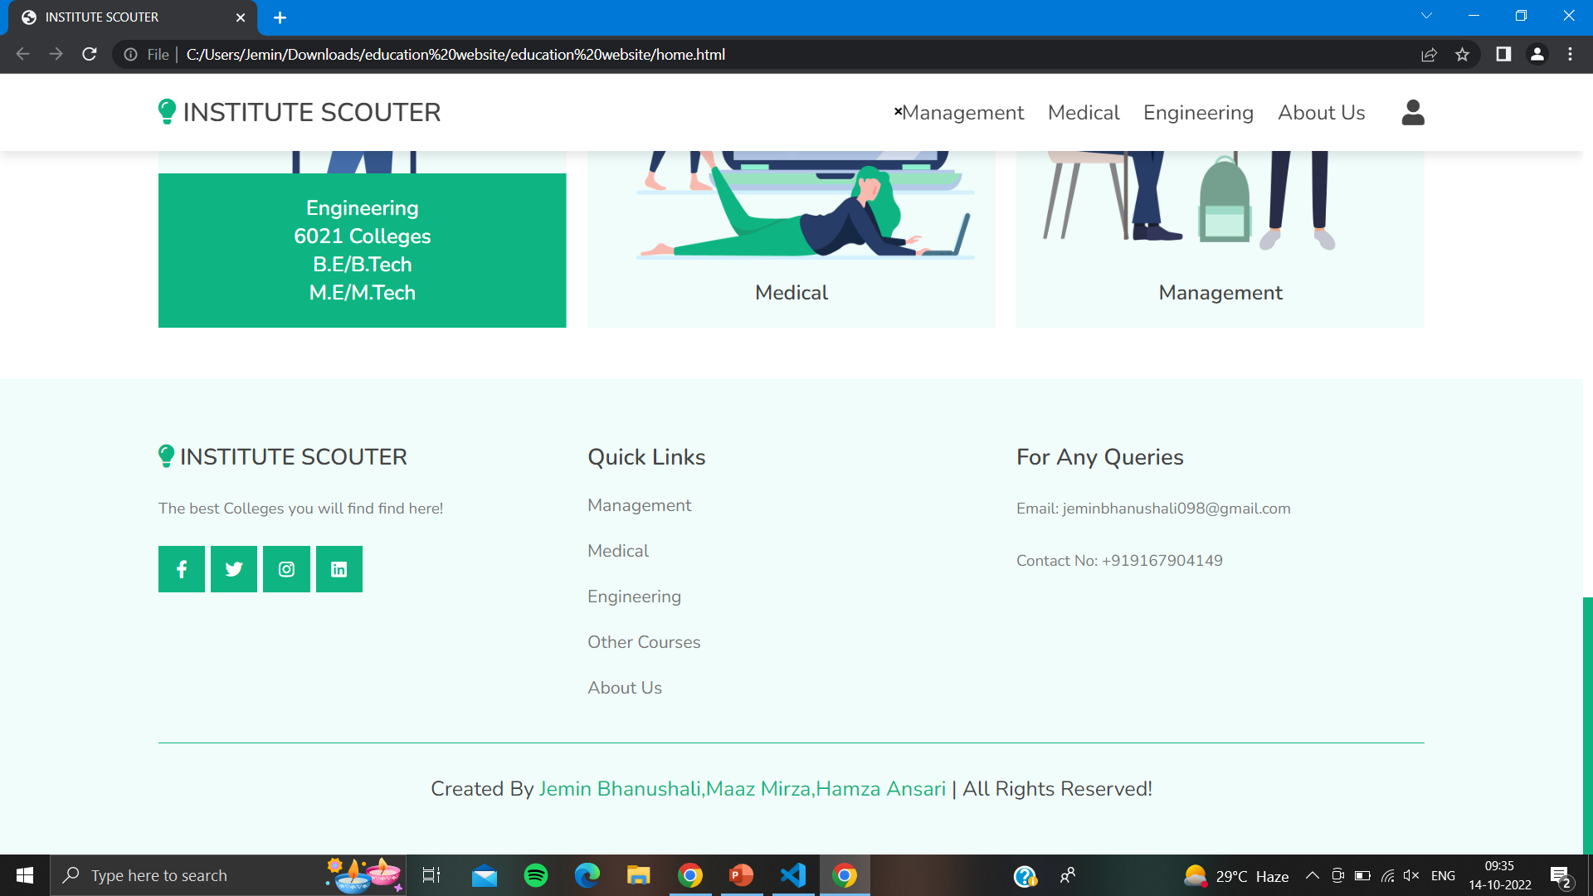
4: Home Page:

Slide 17
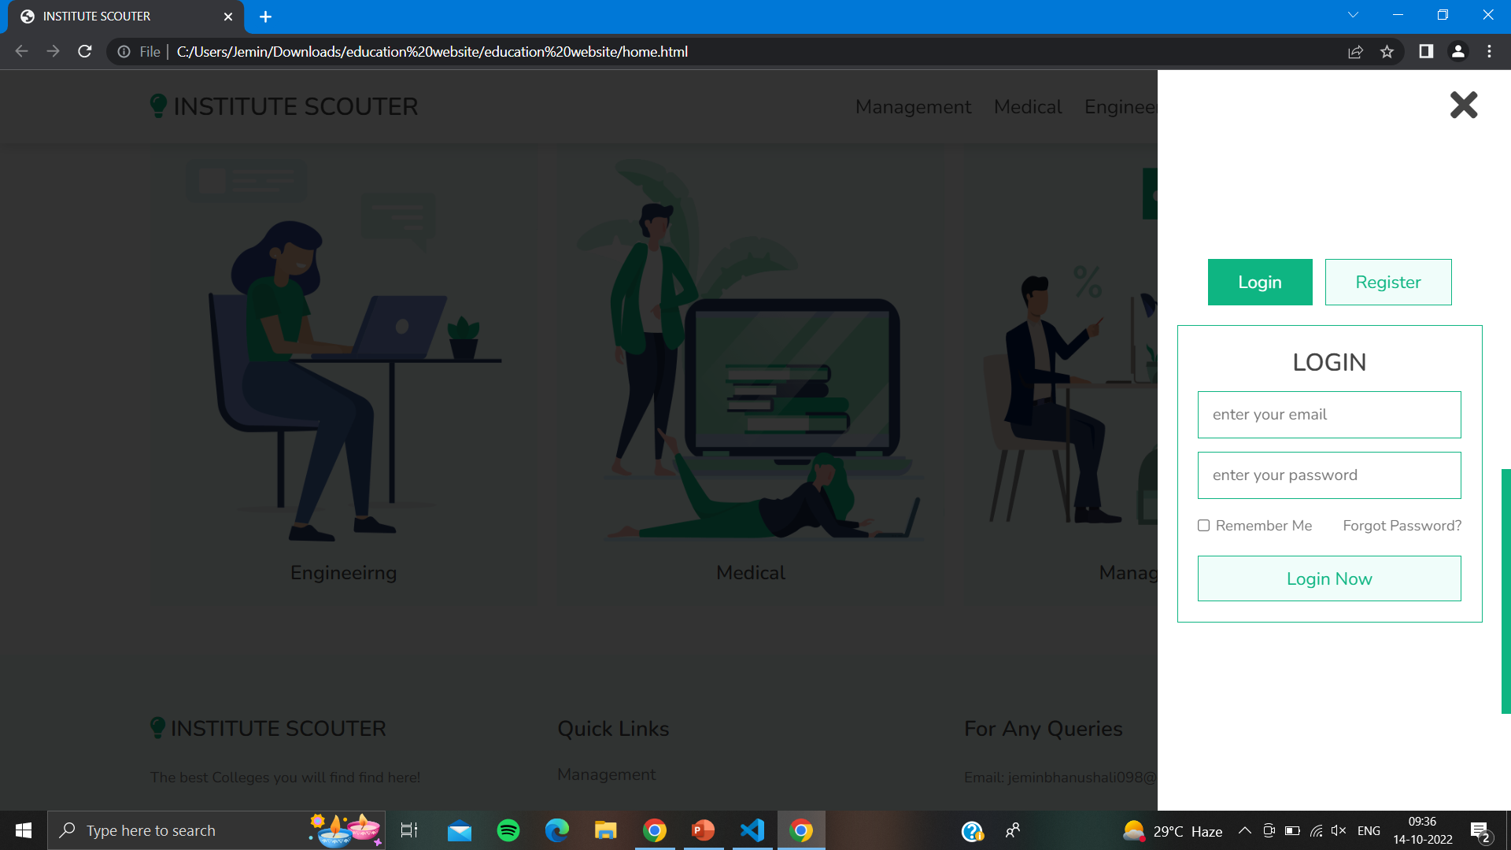
5: Login Page:

Slide 18
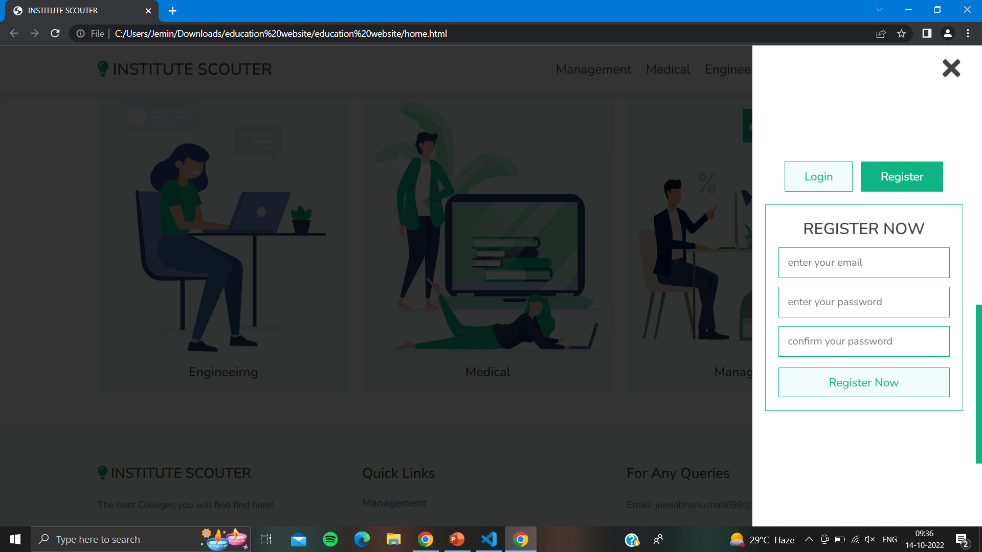
6: Registration Page:

Slide 19
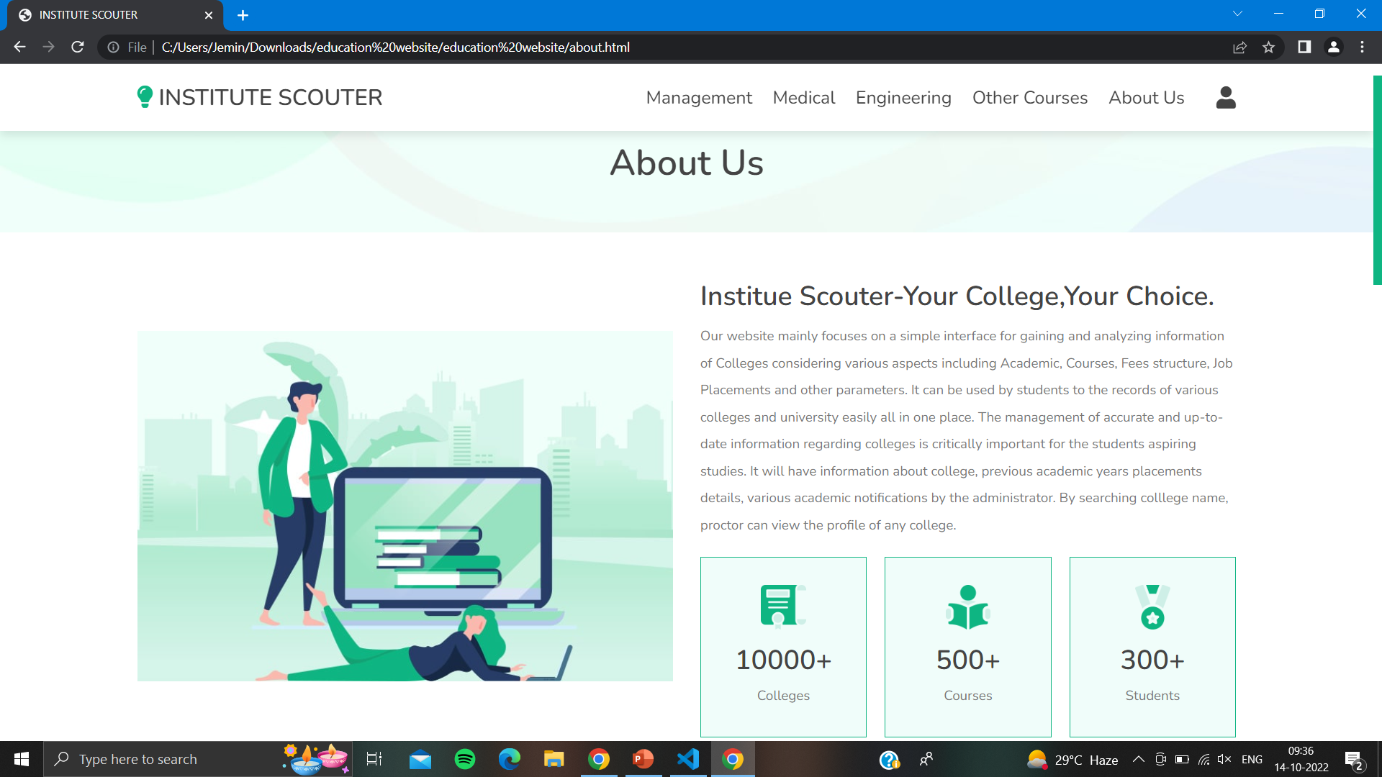
7: About UsPage:

Slide 20
12.Conclusion and Future scope.
CONCLUSION:
Thus, institute scouter is a user-friendly website and has a easy interface to operate which mainly focuses on making the process of college admission more convenient and help students to choose colleges which fits best for them and based on their needs.
FUTURE SCOPE:
Currently our system will be exclusive to only Under Graduate and Post Graduate students but in the future, SSC and HSC students will also be able to take advantage of our system.
It can also be updated in the future as and when requirements for the same arises.

Slide 21
12.References.
https://www.shiksha.com/
https://collegedunia.com/
https://www.ijert.org/college-recommendation-system
https://www.irjet.net/archives/V7/i3/IRJET-V7I31057.pdf

Slide 22
Thank You...!!

